Slide 1



BIOREACTOR
Introductory Level -- July 2017

Slide 2
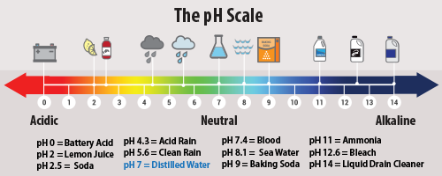
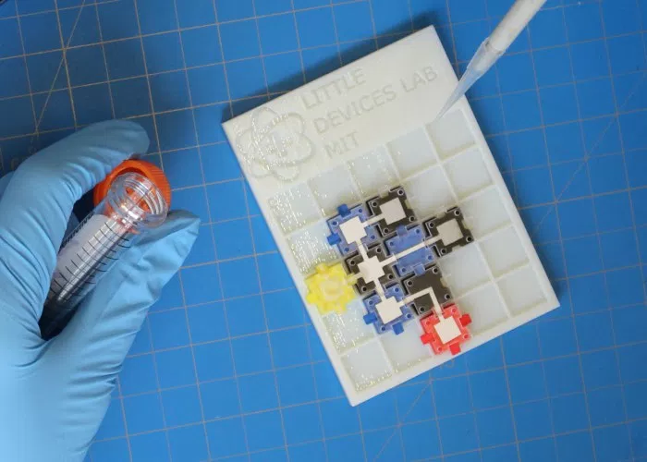
Chemical Circuit Design -- what can you design using food coloring, pH detection, and a mild acid?l
Notes:
Flow and pH experiments

Slide 3
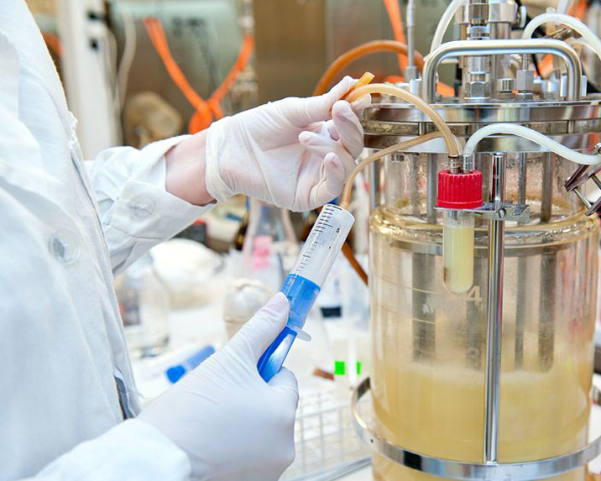
noun
an apparatus in which a biological reaction or process is carried out, especially on an industrial scale.
Fermentation chambers are bioreactors where organisms (yeast) grow and produce useful produce chemicals or products.
What is a Bioreactor?
Notes:
https://www.google.com/search?q=bioreactor&source=lnms&tbm=isch&sa=X&ved=0ahUKEwjh1J3bybLVAhWI7YMKHSzYB-wQ_AUICigB&biw=787&bih=716#imgrc=2zFrFDQcCliPYM:

Slide 4
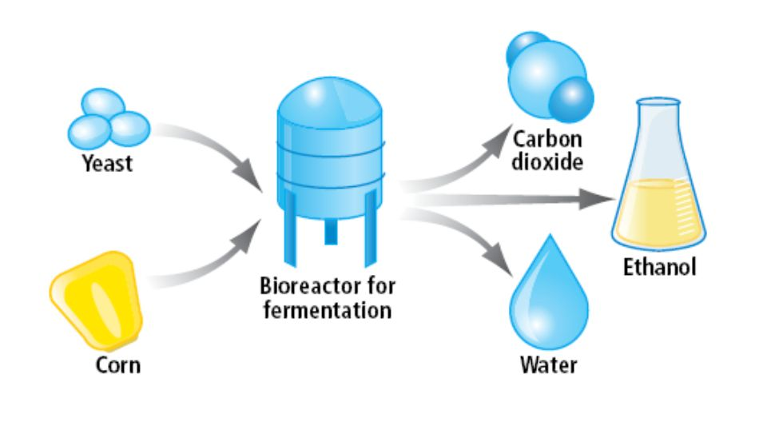
In a typical plant, we need to connect the fermentation tanks, with other tanks that collect useful products
Notes:
http://slideplayer.biz.tr/slide/10943534/

Slide 5
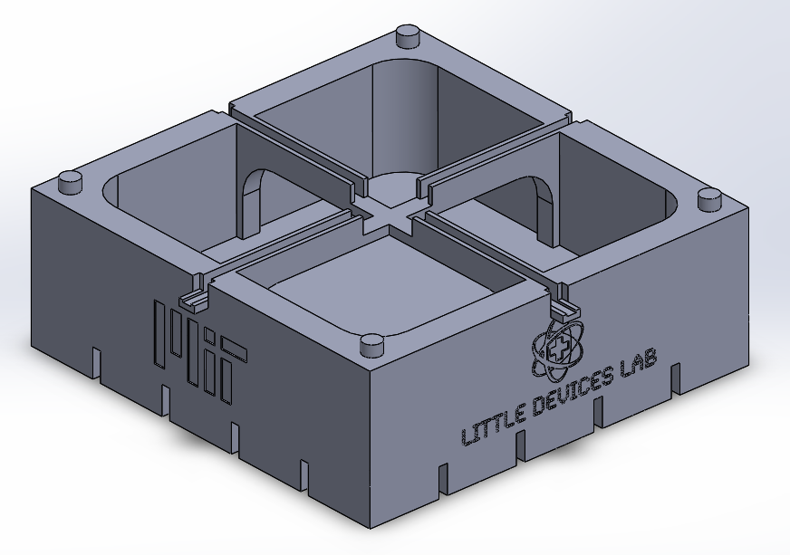
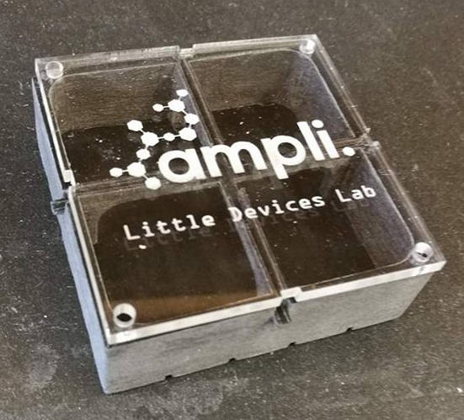
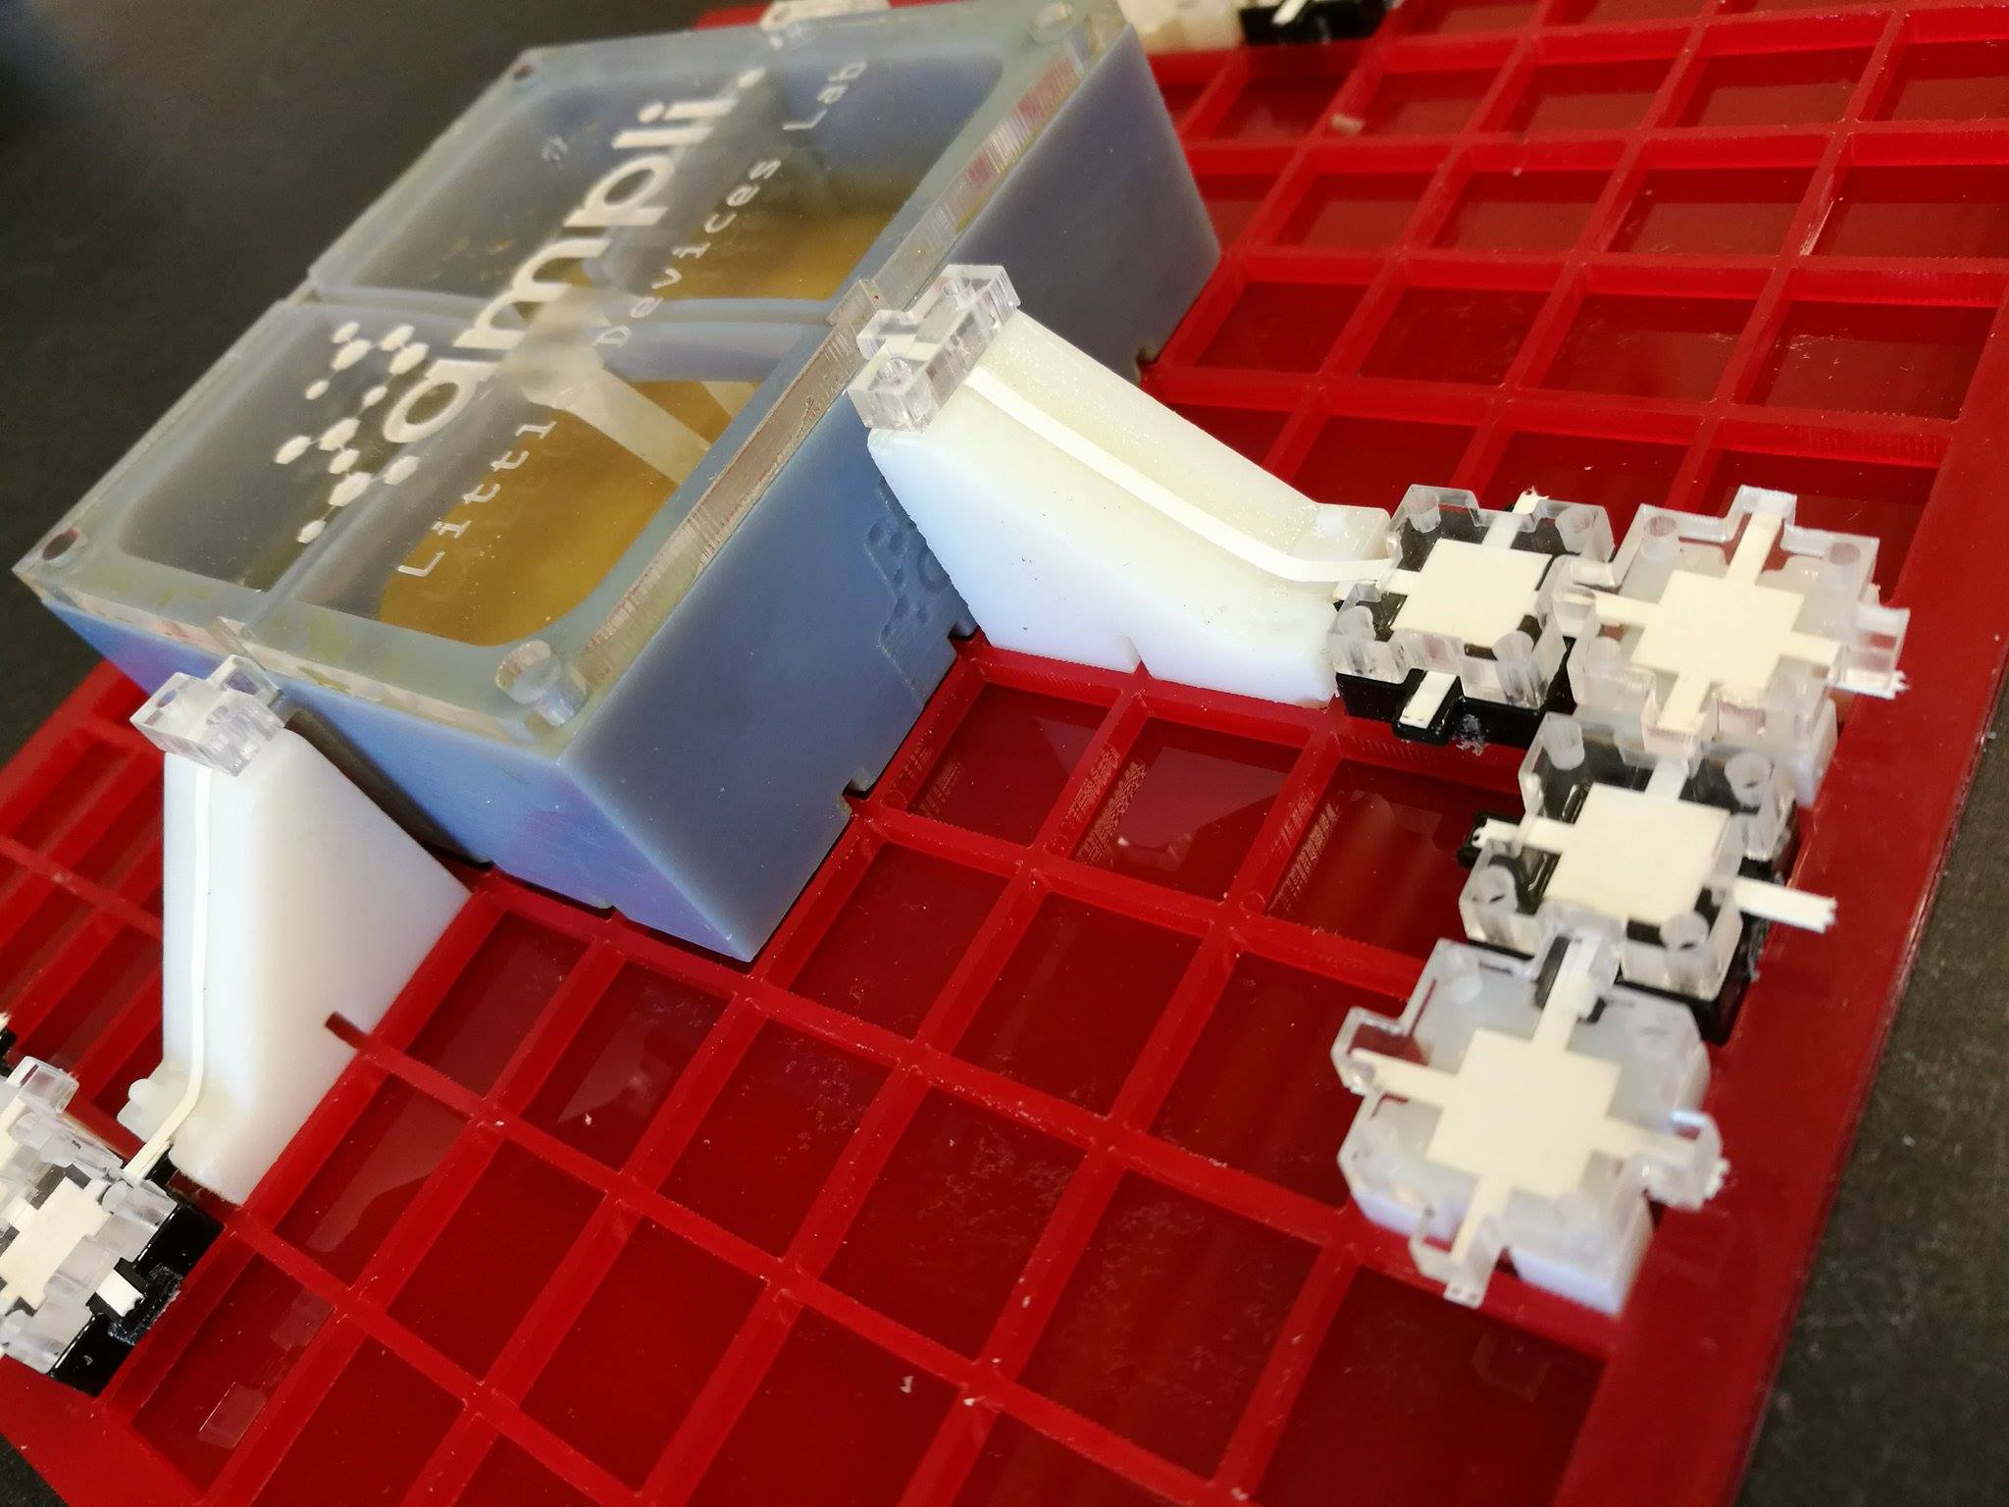
The Ampli Bioreactor
Notes:
Kept weird photo for presentation

Slide 6
Ampli Bioreactor
Introductory Level
BIOREACTOR

Slide 7
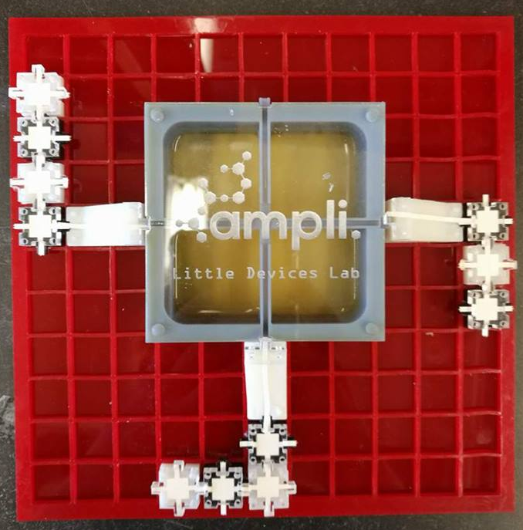
Introductory Level Ampli activities:
Free-form experiment design:
Test flow with food coloring
Raise and lower pH
Create chemical circuits!
Study fermentation:
Examine & quantify ethanol production
Observe by-products of fermentation such as pressure & temperature changes
Compare fermentation to regular yeast growth

Slide 8
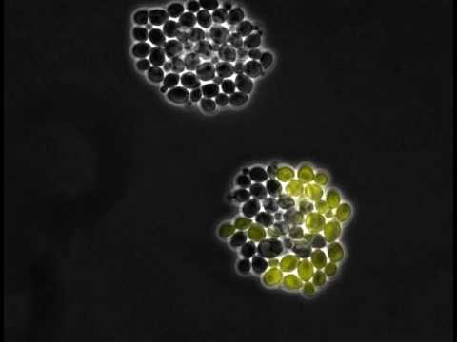
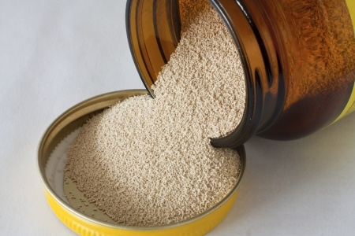
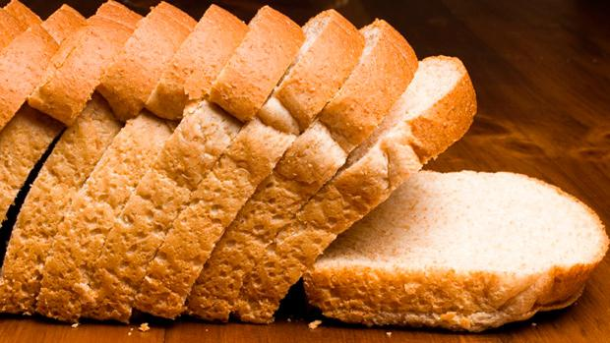
Yeast are single-celled microorganisms that you might commonly find in both labs and kitchens
Notes:
Bread pic: https://www.t-nation.com/diet-fat-loss/the-truth-about-bread

Slide 9
Yeast require certain things to live and grow:
Nutrients and sugar (in growth medium, or fruit/vegetable/grain mash)
Warm environment
Life-safe pH (range around pH 7)
Notes:
About yeast and growth

Slide 10
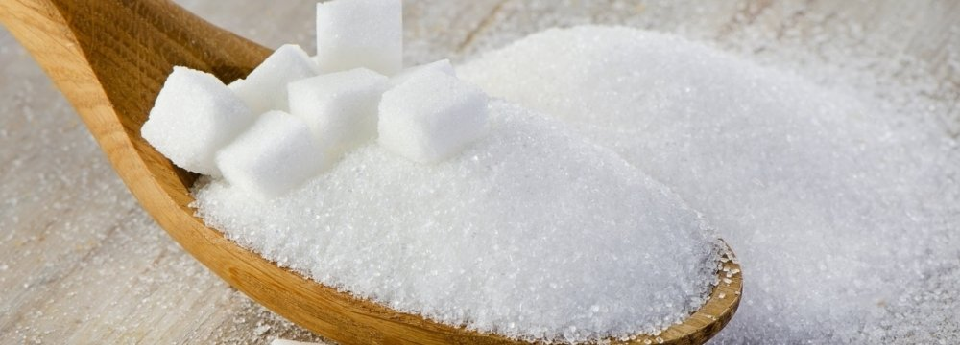
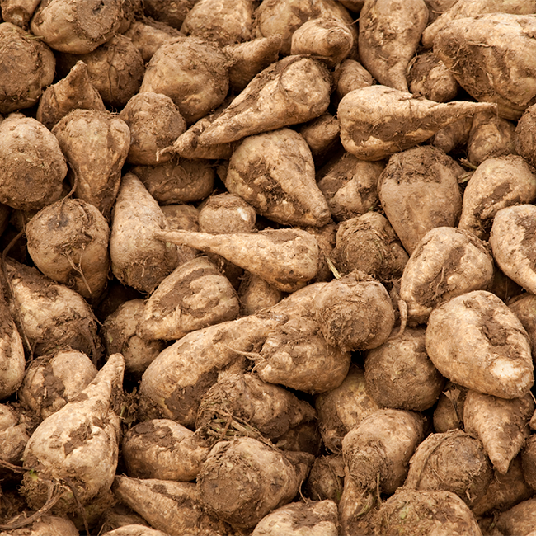
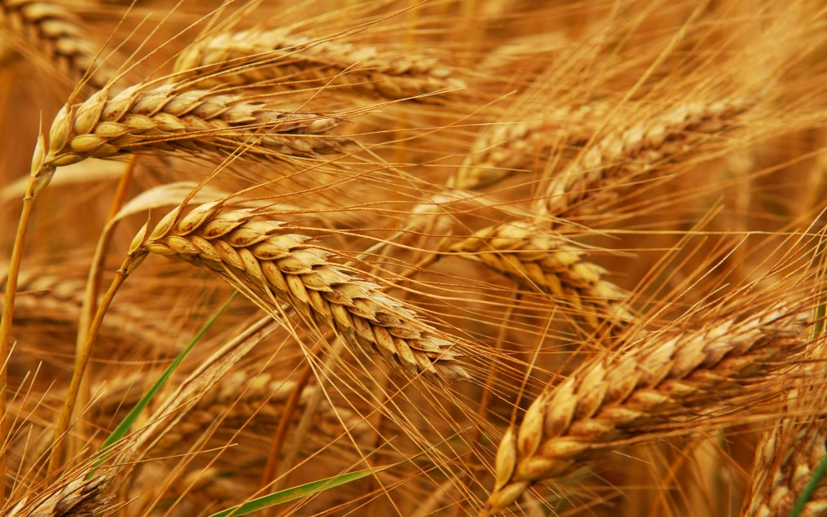
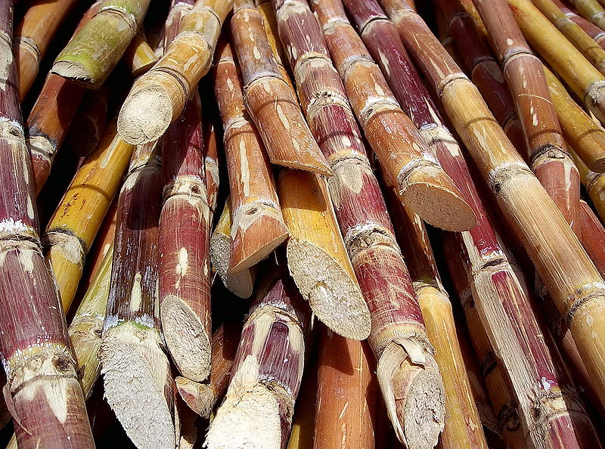
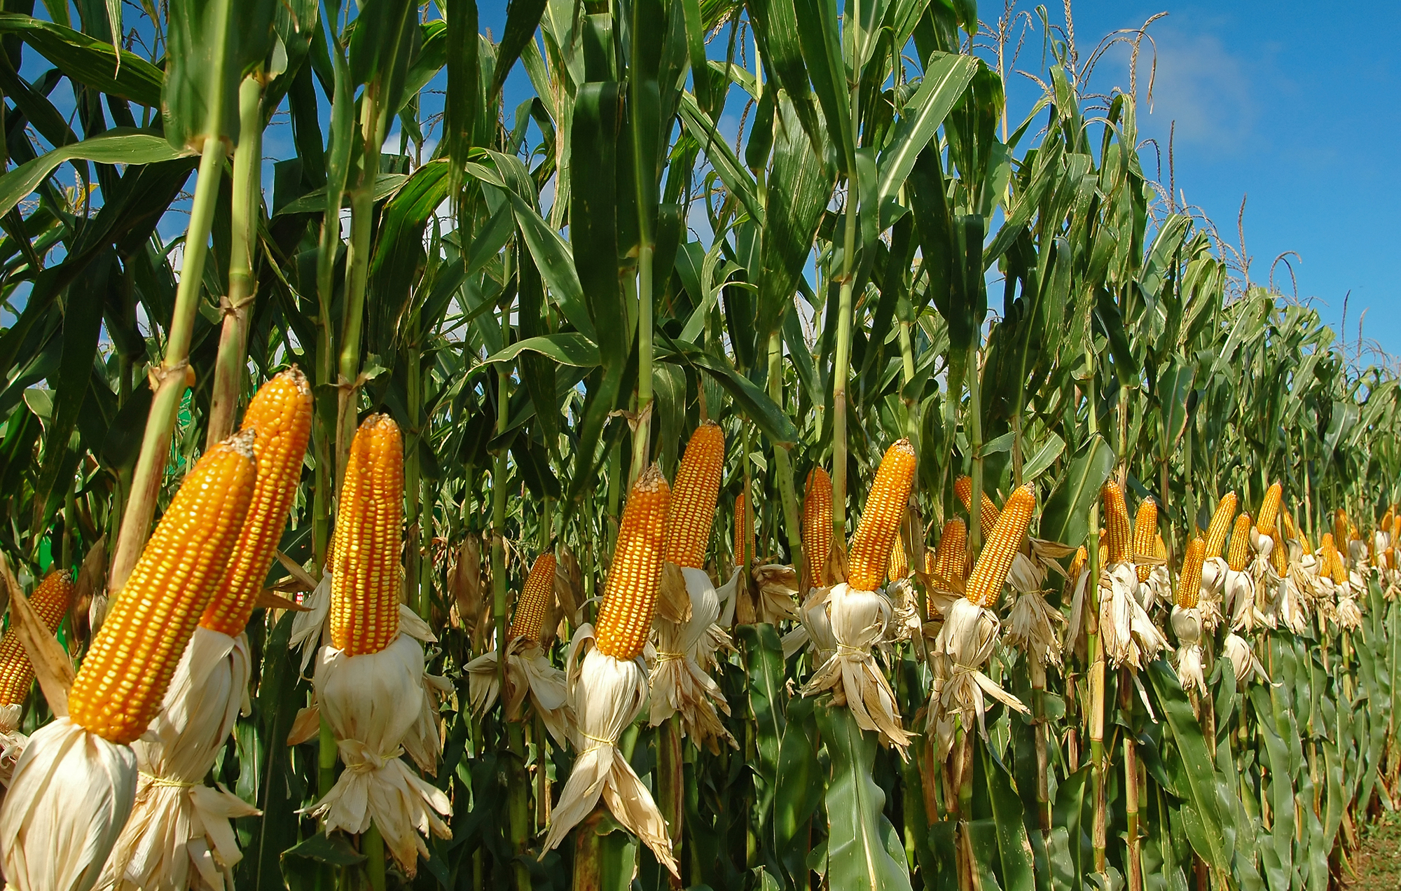
Yeast consume sugars (everything from wheat, barley, rice, and corn, to lab glucose)
Notes:
Images: http://www.weightzonefactor.com/blog/why-whole-wheat-bread-is-not-healthier-than-white/, https://financialtribune.com/articles/economy-domestic-economy/63081/gov-t-slashes-sugar-import-tariffs

Slide 11
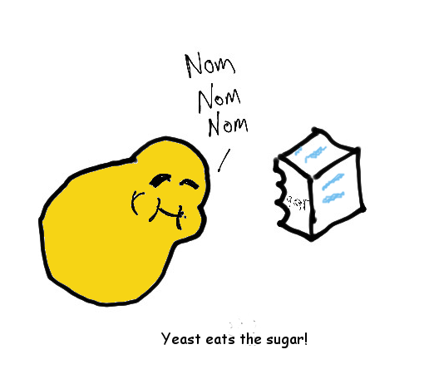
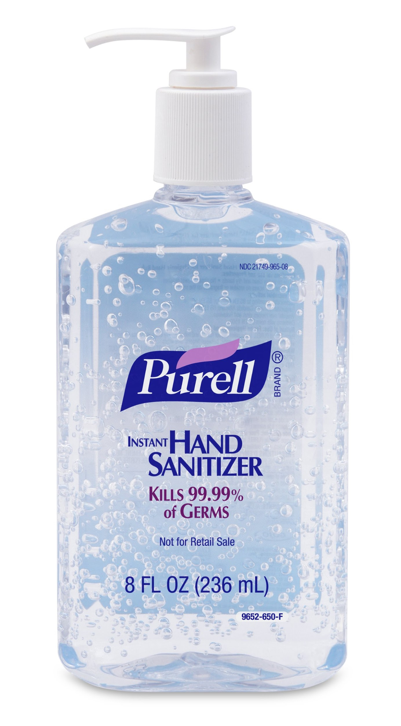
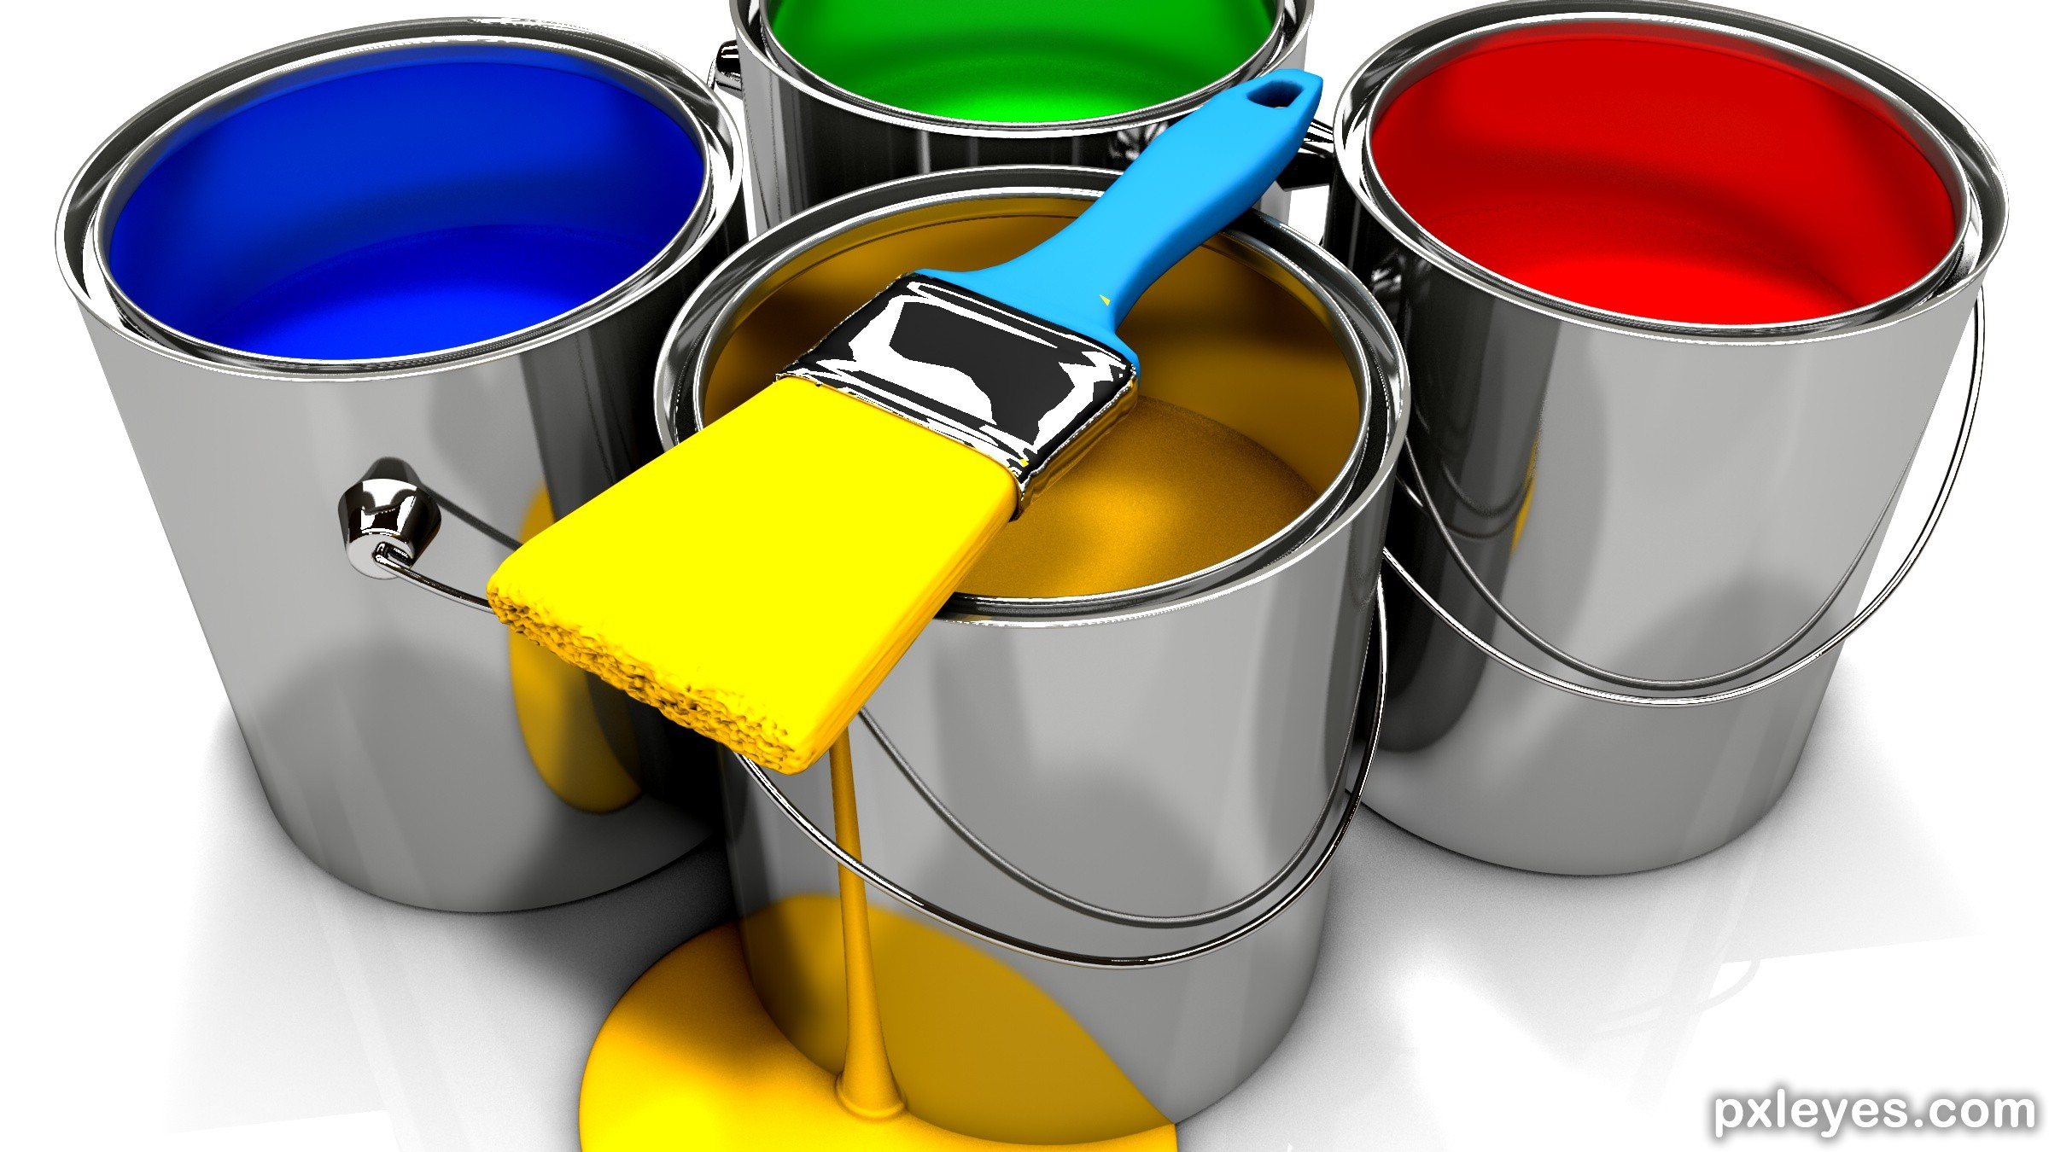
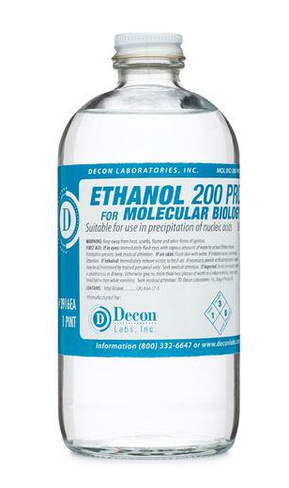
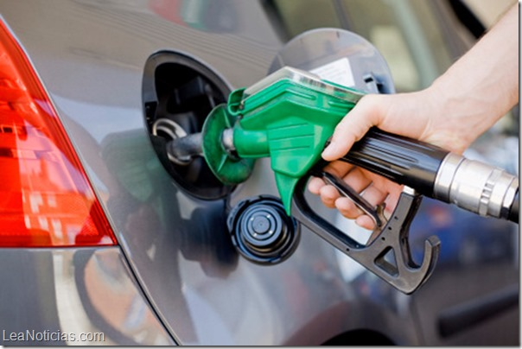
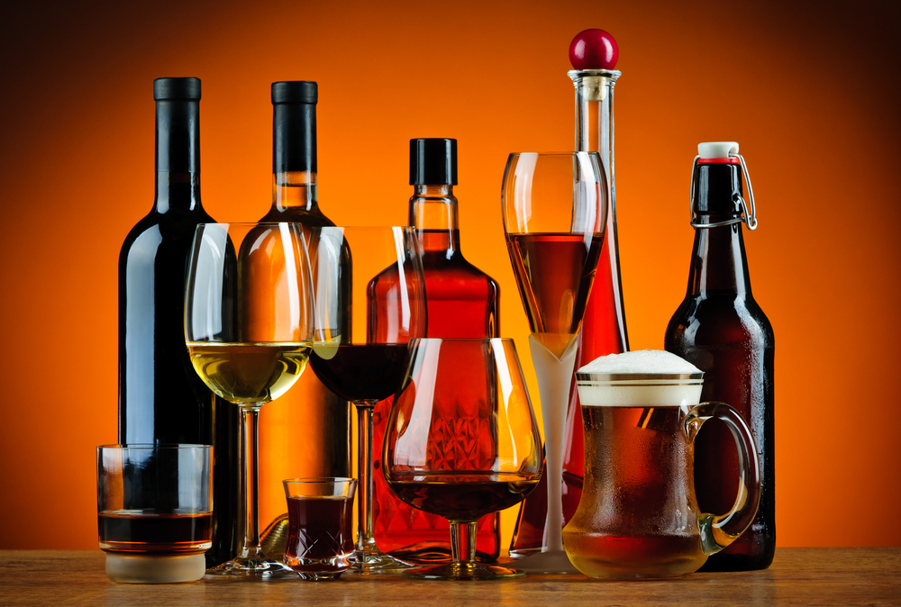
When yeast eat sugar, we call that fermentation and it can produce useful products: CO2 and Ethanol
Notes:
Image credits: http://bigmeankitty.com/fp/wp-content/uploads/2016/05/Alcohol.jpg, http://www.pxleyes.com/3D-contest/21149/brush-up-your-3D.html, http://deconlabs.com/products/molecular-biology-ethanol/,

Slide 12
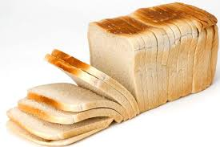
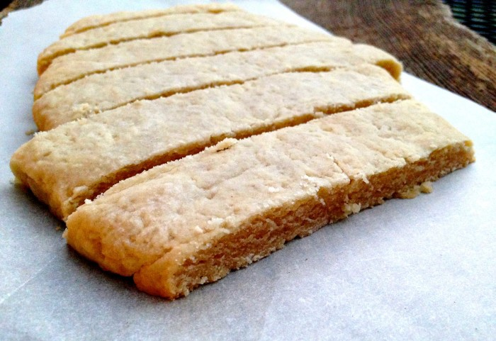
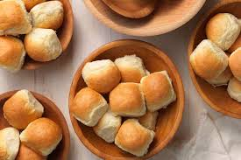
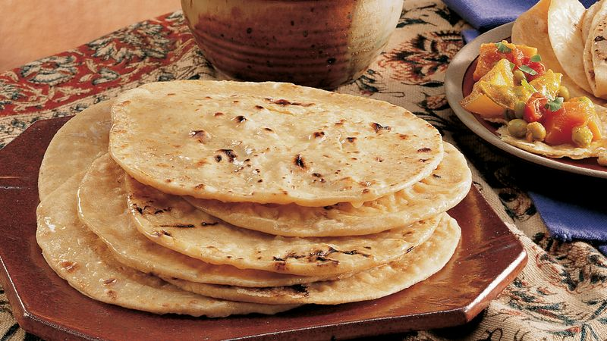
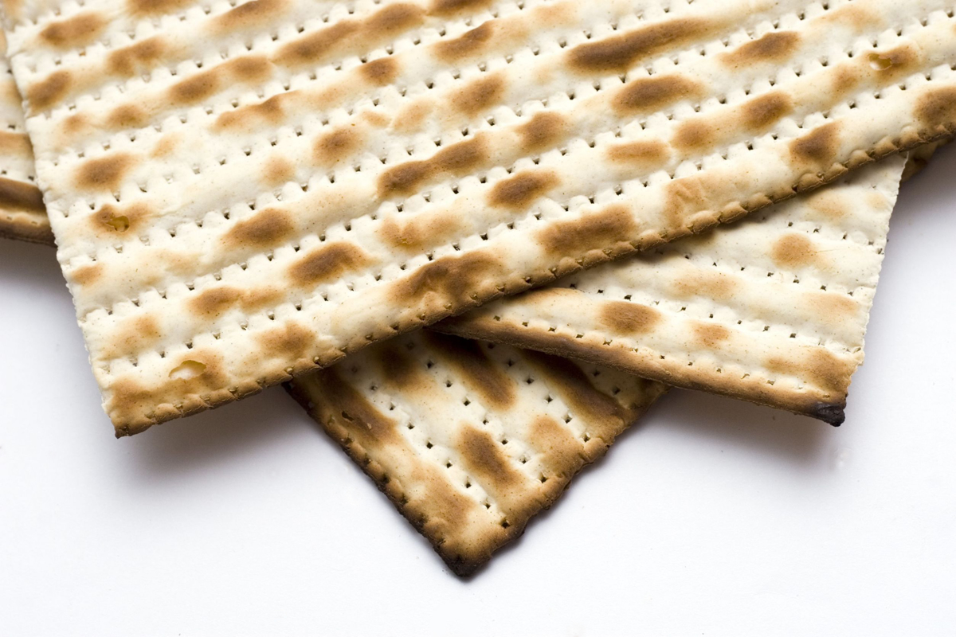
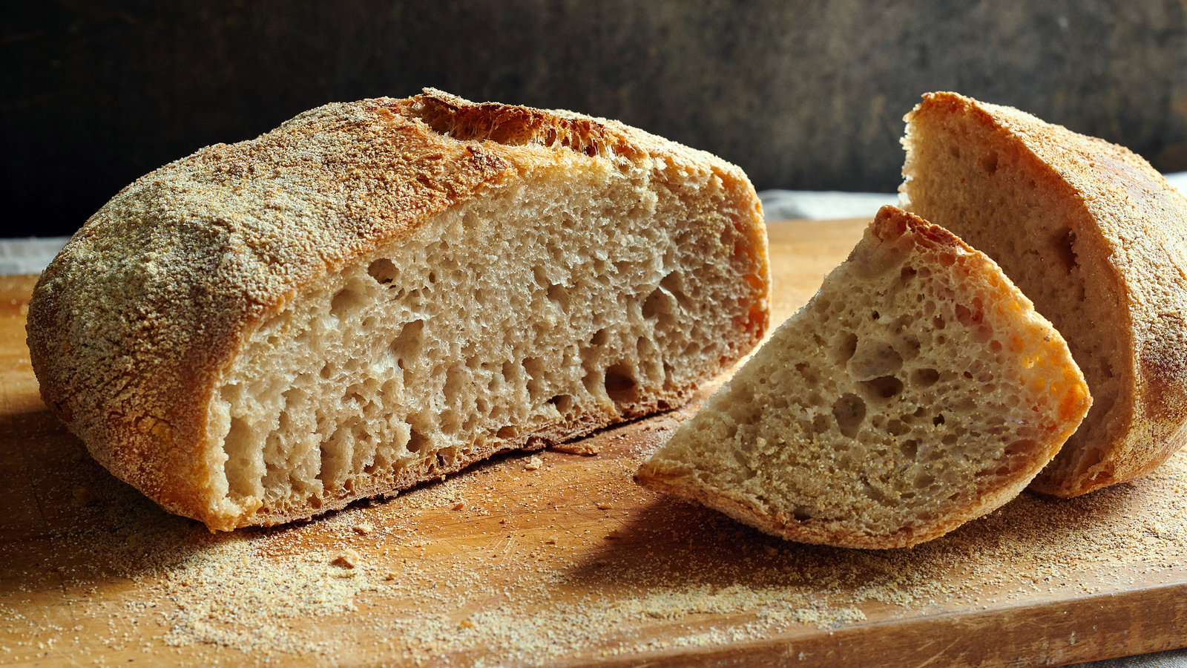
Leavened
Unleavened
Yeast and Bread
Yeast eats sugar and releases carbon dioxide and alcohol.
Yeast contains enzymes that help to break down bread ingredients into simple sugars that the yeast can eat. The air bubbles found in leavened bread are from alcohol and CO2 that is produced when yeast eats these simple sugars.
Notes:
http://www.finecooking.com/article/yeasts-crucial-roles-in-breadbaking

Slide 13
Fermentation happens when...
Yeast have sufficient sugar to consume
Low-oxygen environment
Good yeast life conditions without harsh substances
How do you think each of these factors would affect fermentation? Would you like to test any?
Type of sugar or fruit in the bioreactor
Plastic wrap or regular lid?
pH? Temperature of the bioreactor? Amount of ethanol in the bioreactor?
How do you think fermentation affects pressure in the bioreactor? How about temperature? Think about what you know about energy.
Notes:
What do you think will…. fermentation

Slide 14
Calorimetry
Measure the heat of a reaction by keeping track of how much it raises the temperature of water
Can be used to study many reactions, and even living organism systems! But is often used to study the heat given off by various substances burning, useful in determining the concept of food calories.
We can use it to demonstrate the utility of ethanol as a fuel (and to note the general purity of our ethanol)!

Slide 15
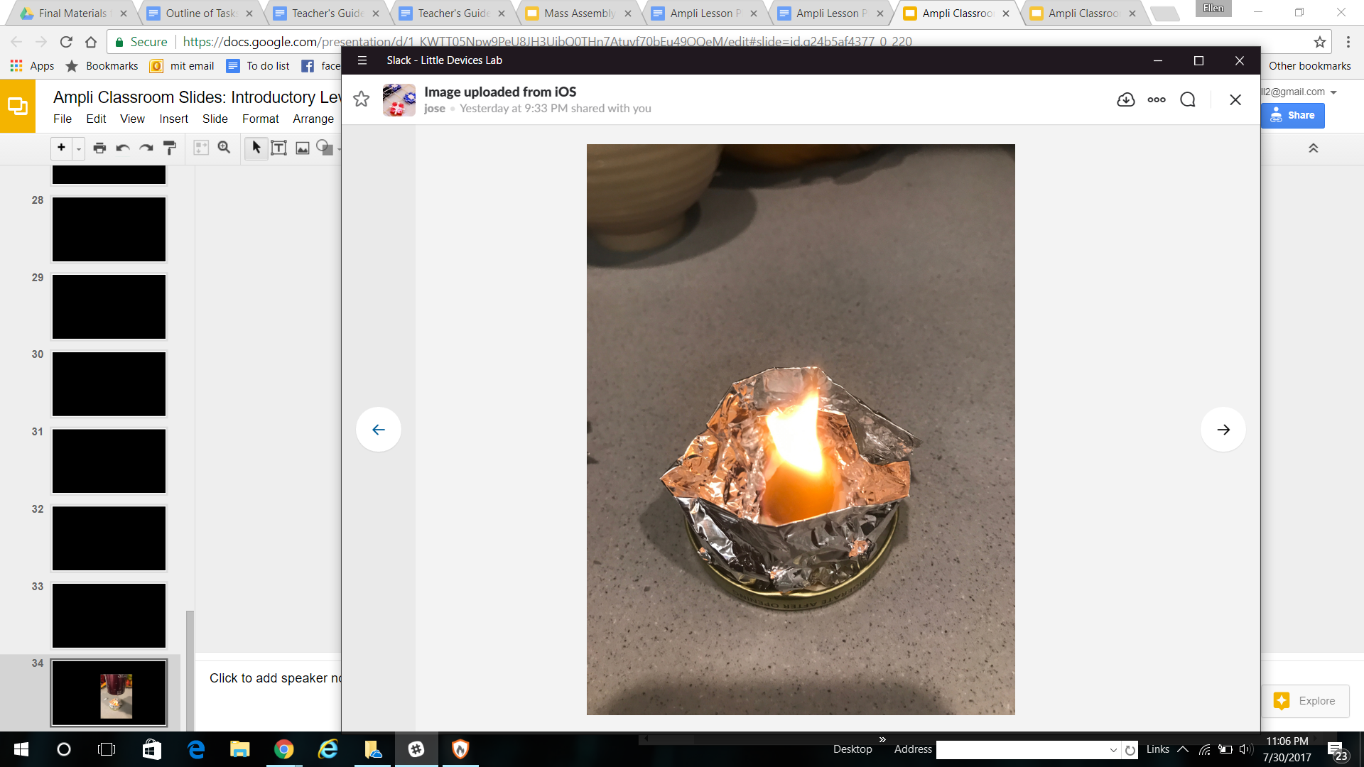
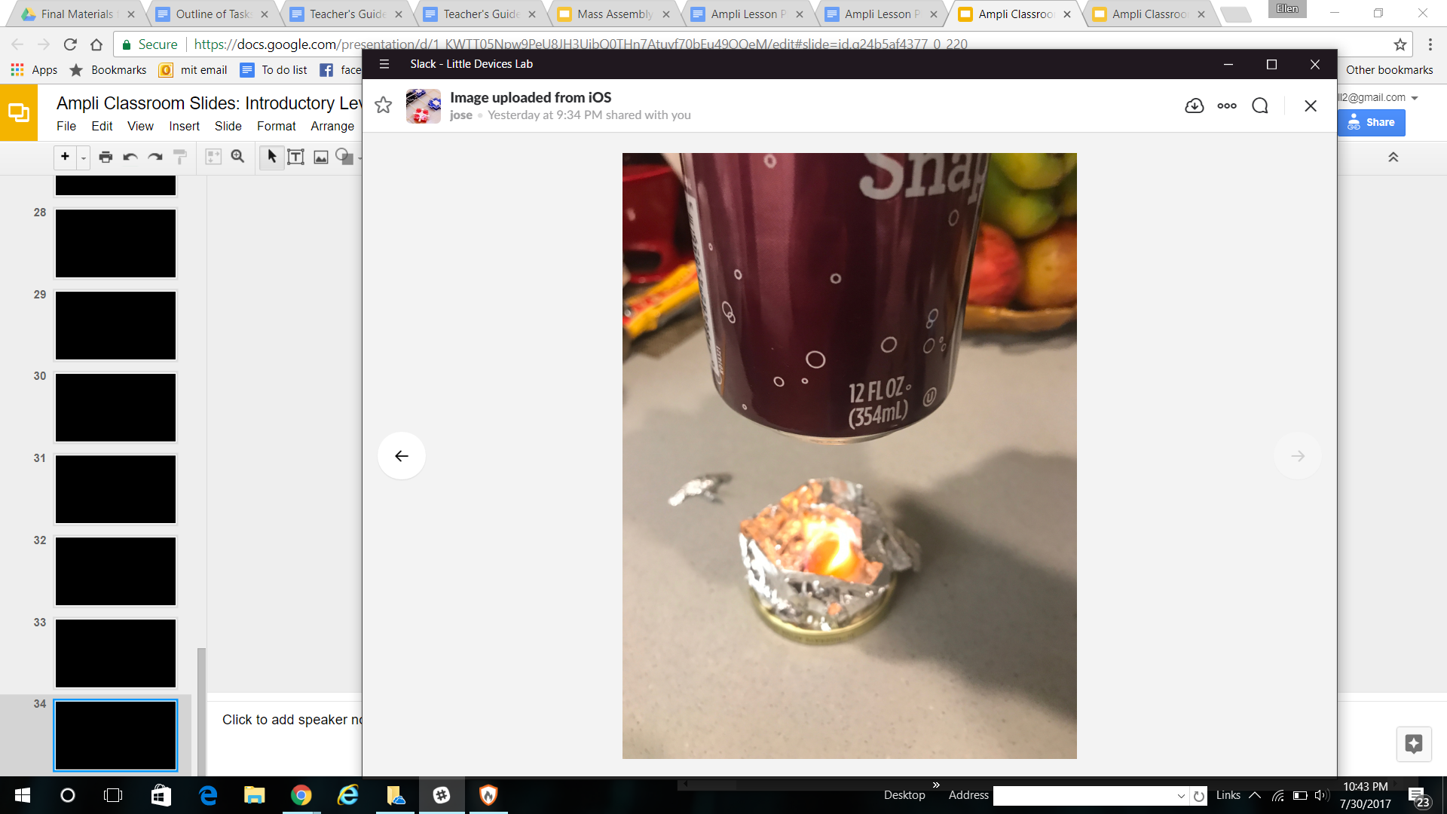
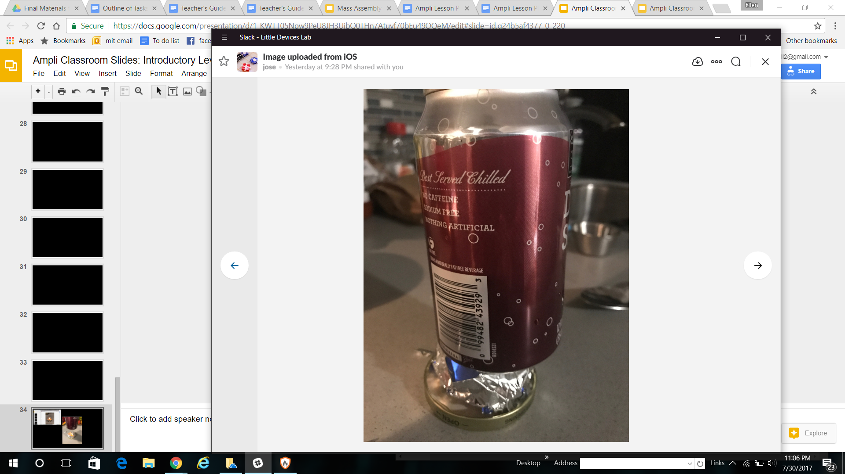
How to Do A Calorimetry Experiment
Notes:
Calorimeter instructi0ns

Slide 16
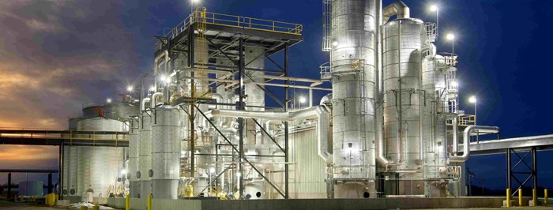
Introduction to Modern Bioreactors
Notes:
http://www.interstates.com/experience/experience-detail/18/Ethanol_Plant

Slide 17
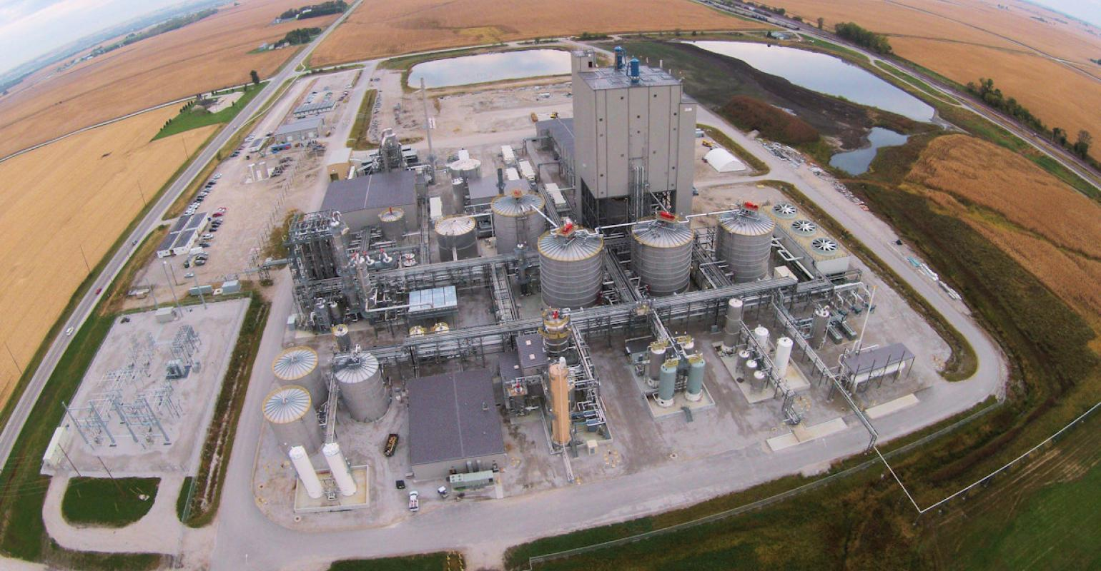
The picture below and on the previous slide are both of ethanol plants - which do many of the same things as our small bioreactors.
These are cars!
Why are there ethanol plants this large?
Hint: it was touched on previously and you have just seen an image of the answer

Slide 18
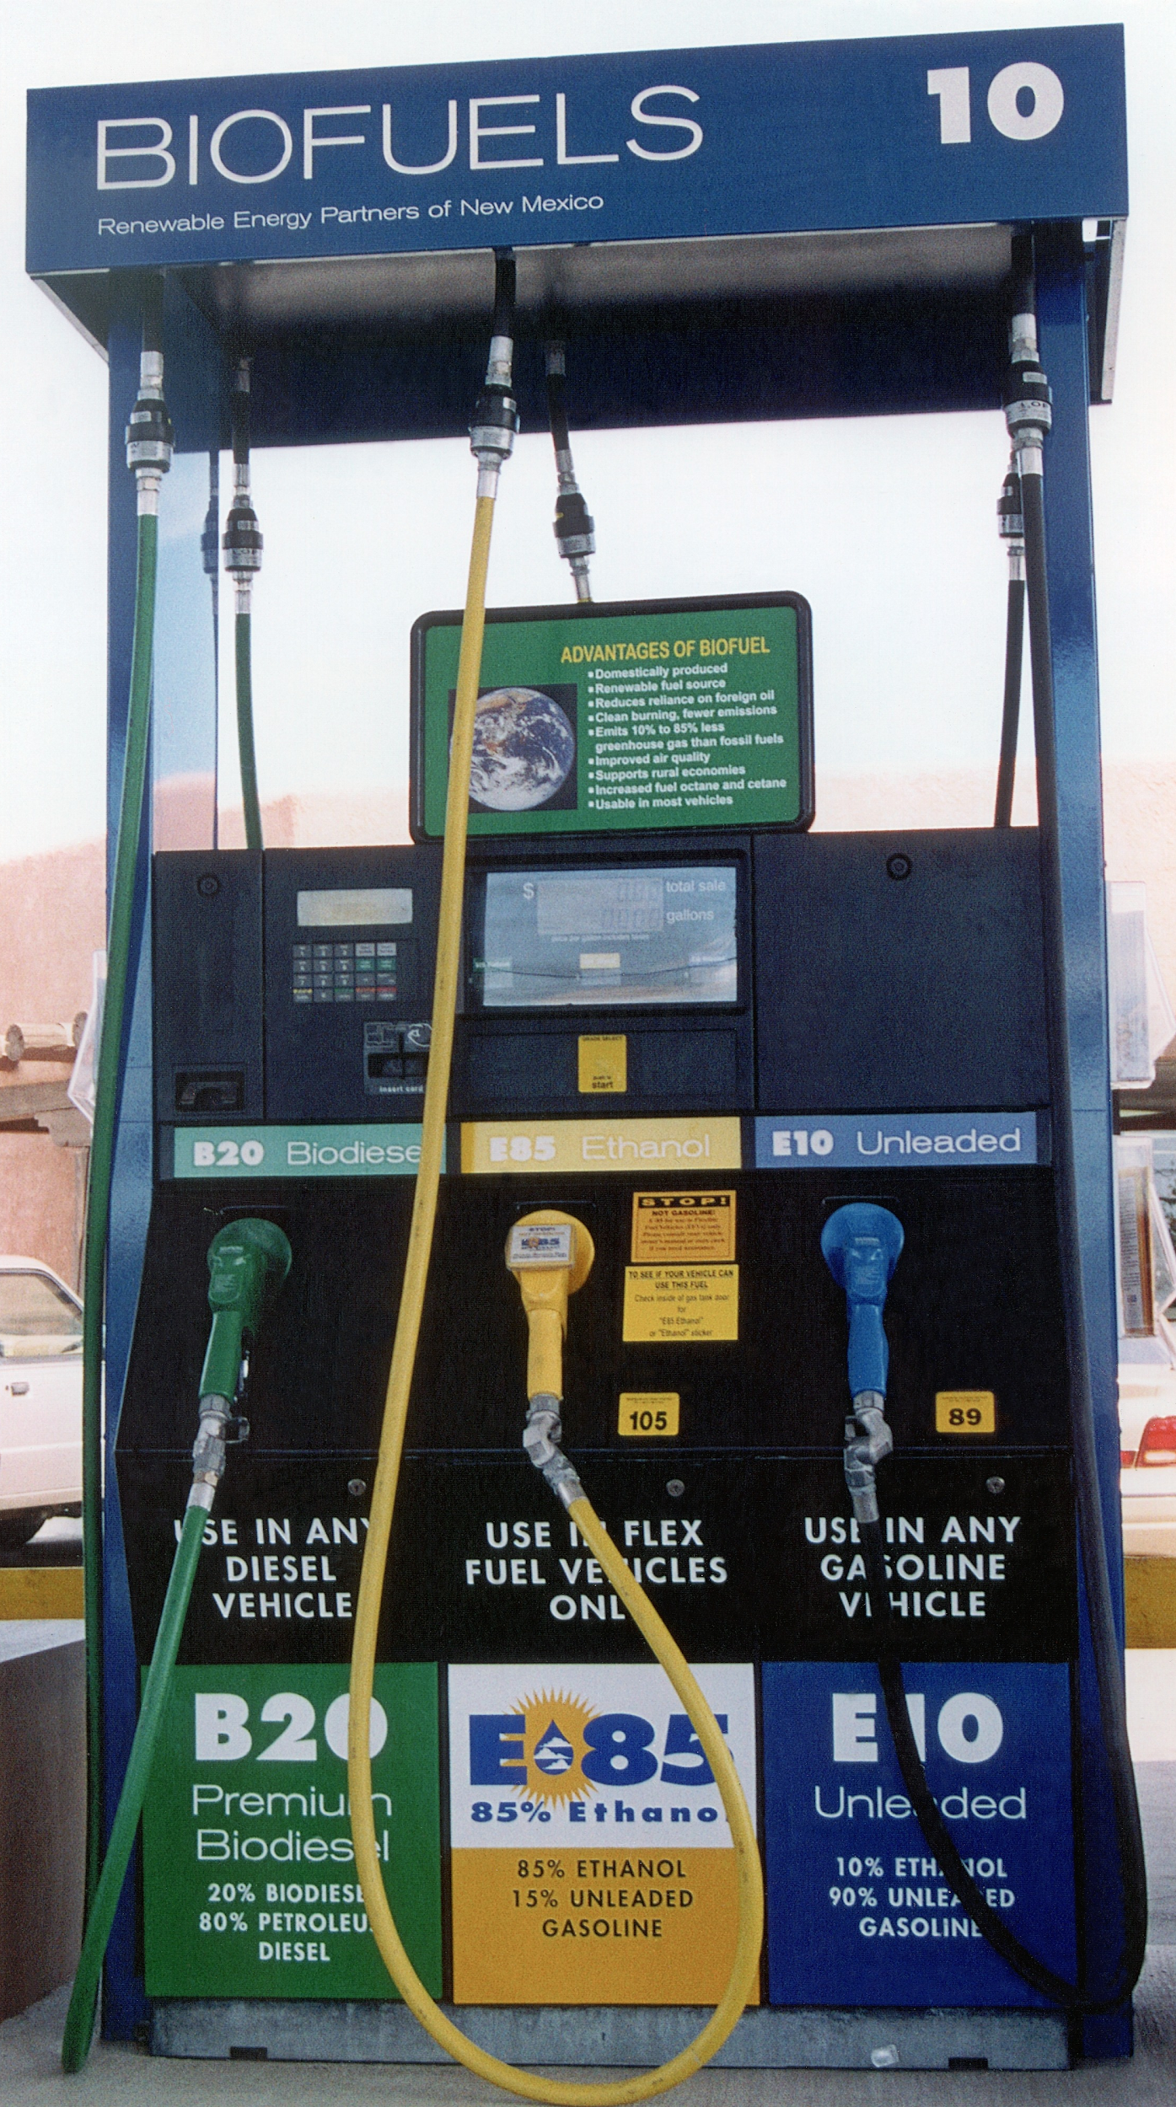
Ethanol as a Biofuel
Ethanol is made from biomass (plant materials) and today is present in upwards of 97% of U.S. gasoline where it helps to reduce air pollution and serves to oxygenate the gasoline
Most of the ethanol produced in the US is made from corn grain and it has a positive energy balance
A positive energy balance is when the sum total of the energy that went into the corn and the fuel production is less than the total energy contained in the fuel

Slide 19
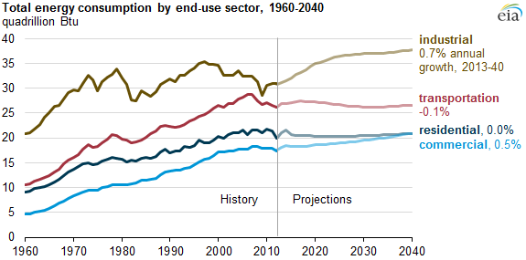
Energy Demand
Source: U.S. Energy Information Administration
Notes:
https://www.eia.gov/todayinenergy/detail.php?id=21012

Slide 20
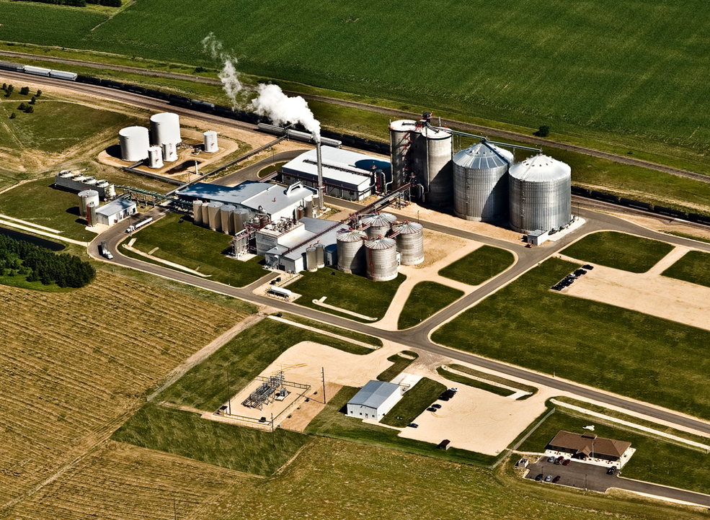
Ethanol plants are complex and it is not obvious what function each component serves
Notes:
http://ethanolproducer.com/articles/7963/western-wisconsin-energy-55-mmgy-ethanol-plant-up-for-grabs

Slide 21
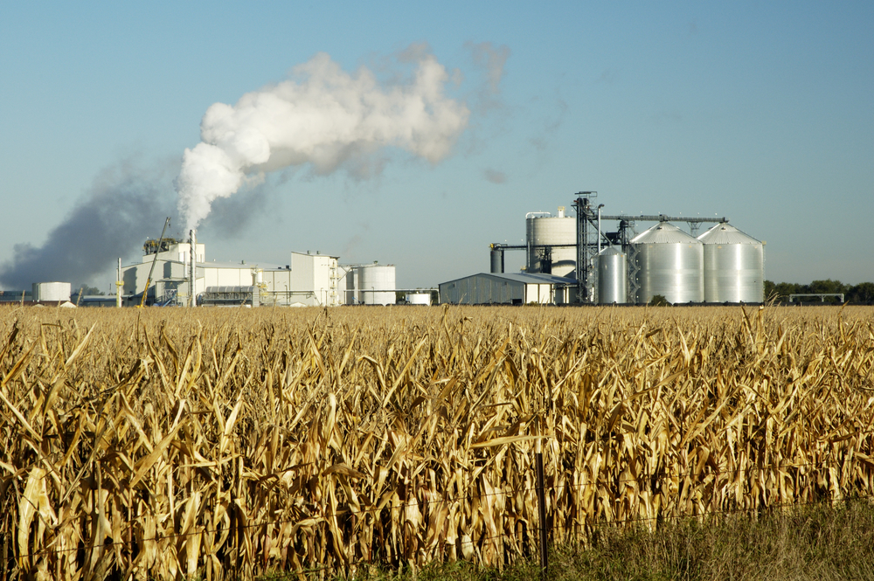
Functions of an Ethanol Plant
Corn storage and milling - grinding corn
Saccharification - heating and cooling a corn mixture
Fermentation
Distillation - purification using boiling
By-product processing - converting by-products into useful forms
Notes:
https://teeic.indianaffairs.gov/er/biomass/restech/desc/ethanolplants/index.htm

Slide 22
What about the physical details? How do machines perform those tasks?
Is there a way to design the plant in a way where you can understand what each component does just by looking at the plant?
Where are these steps happening?
How would you design a machine or system to complete the tasks of each step?
How would you go from one step to the next?
How would you design an ethanol plant?
Use paper to sketch out your ideas and be ready to share them with the class.

Slide 23
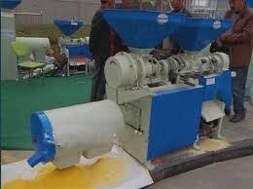
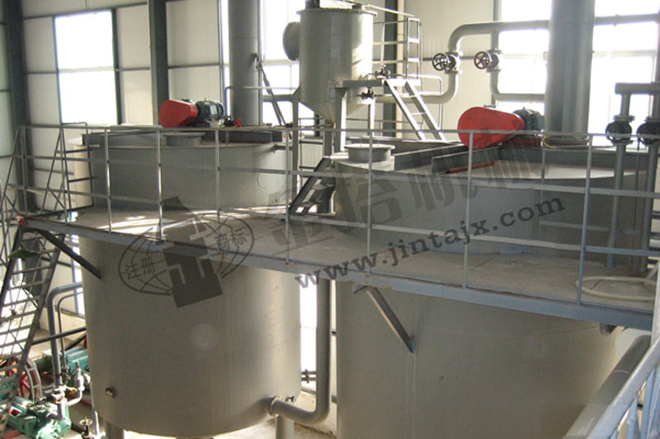
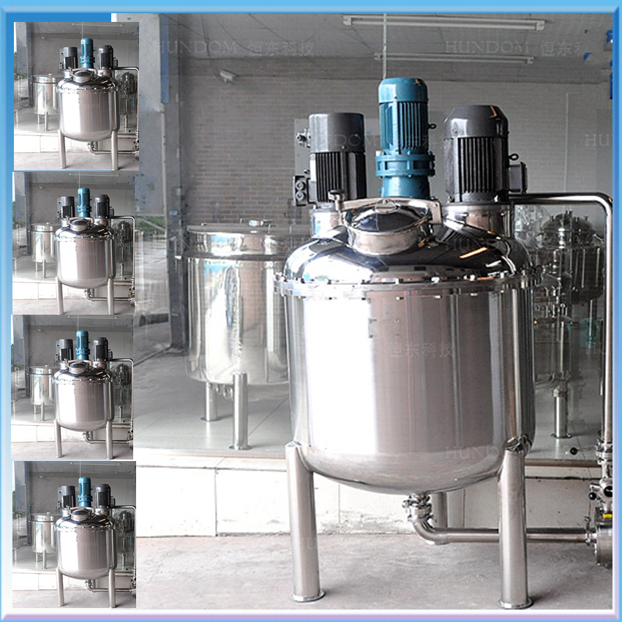
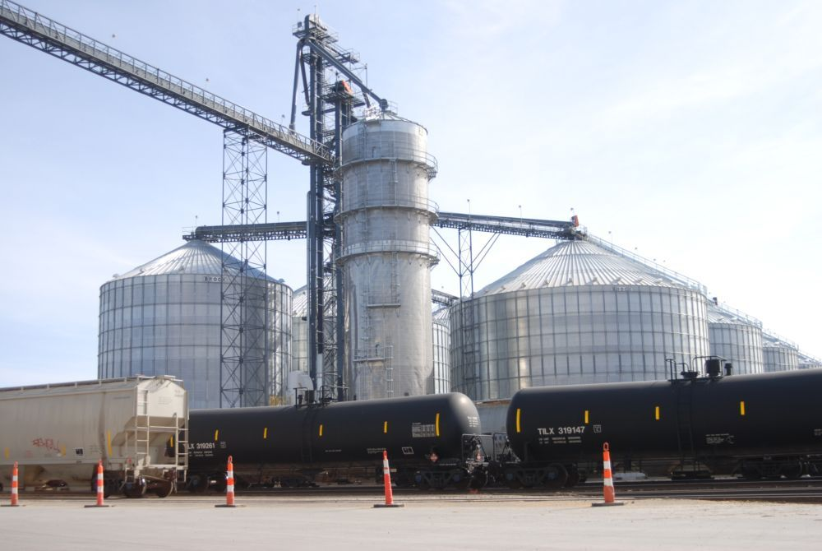
1. Corn storage and milling - the corn is ground down into smaller pieces and stored
2. Saccharification - finely powdered corn is put, along with enzymes, into hot water and then cooled
Corn Milling Machine
Saccharification Chamber
Fermentation Chamber
3. Fermentation - you know all about this step
Corn Storage
4. Distillation - the mixture is purified by heating the ethanol and allowing the ethanol gas to condense into a more pure version of ethanol
5. By-product processing - methods are used to remove many by-products
Notes:
http://en.jintagroup.com/products_detail/productId=80.html
http://megaplantyu.com/product_xxx.asp?id=817
https://sc02.alicdn.com/kf/HTB10RSUKpXXXXaHXFXX760XFXXXh/Hot-sale-Marmita-Machine-Fermentation-Tank.png

Slide 24
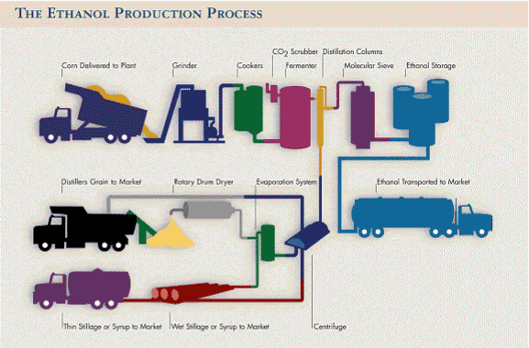
Source: Renewable Fuels Association
0:36 - 2:47
https://www.youtube.com/watch?v=6HrJqQI9joI

